Slide 1
Optimal Siting of Soil Moisture Sensors in Irrigated Production Fields
Pedro Rossini
Graduate Research Assistant
Soil water processes lab
Department of Agronomy
Andres Patrignani
Soil Water Processes
Department of Agronomy
Kansas State University

Slide 2
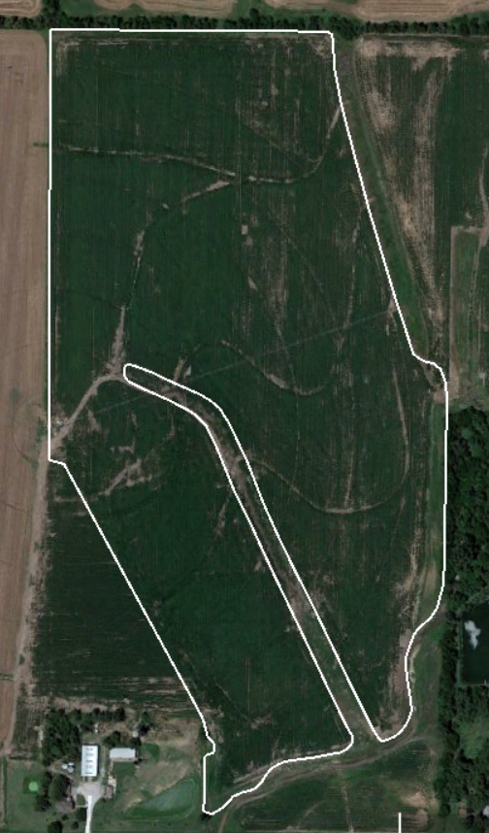
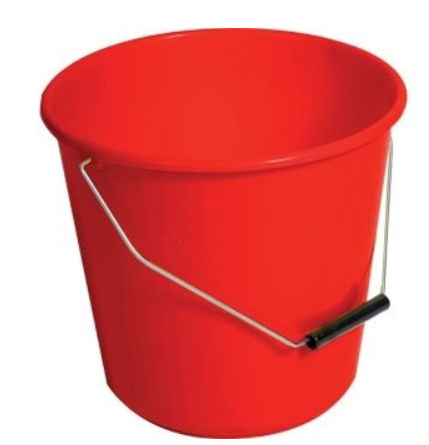
How do you select the location of a limited number of soil moisture sensors?
♂
12 cm rods
One million times smaller in volume
Notes:
Imagine there is a farmer
Invest in a irrigated system 3000 usd
Will focus in summer crops
The farmers is interested in irrigated properly and don’t weist water
Lest put some soil moisture sensors to monitoring soil moisture and help to take management decision
Where is the best place to locate the sensors??

Slide 3
Current tools to take a decision
Subjective methods:
Farmers: the closest place to the center of the pivot
Companies: Select a representative site of the field
Researches: based on management zones
Yield monitors (Flowers et al, 2005)
Topographic indices and EC (Frausse et al, 2001)
Soil fertility approach (Ortega & Santibáñez, 2007)
However, there is not a quantitative method to decide where sit the soil moisture sensors based on soil moisture

Slide 4
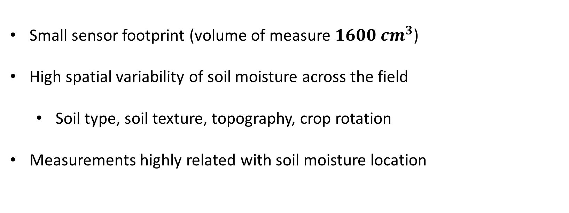
Why optimal siting is important?
Small sensor footprint (volume of measure $1600 {cm}^{3}$)
High spatial variability of soil moisture across the field
Soil type, soil texture, topography, crop rotation
Measurements highly related with soil moisture location

Slide 5
Research questions
Where do we place a limited number of soil moisture sensors?
What are the soil physical properties driving soil moisture spatial and temporal variability?
Objective
Develop a quantitative protocol to decide the optimal location of a limited number of soil moisture sensors in irrigated fields
Hypothesis
Large production fields exhibit temporally stable soil moisture patterns that can be used to guide the permanent siting of soil moisture sensors.

Slide 6
Irrigated production fields in the study
2018 – Hutchinson, KS.
Area: 115 acres
Irrigation technology: Central pivot
Crop: Corn
Main soil type: Udic Argiustolls
2019 – Moundridge, KS.
Area: 54 acres
Irrigation Technology: Central pivot-movie dip irrigation
Crop: Corn
Main soil type: Pachic Udertic Argiustolls
Data analysis:
Matlab R 2018b
Mapping toolbox
Statistics and machine learning toolbox (k-means)
Image processing toolbox (bwdist)

Slide 7
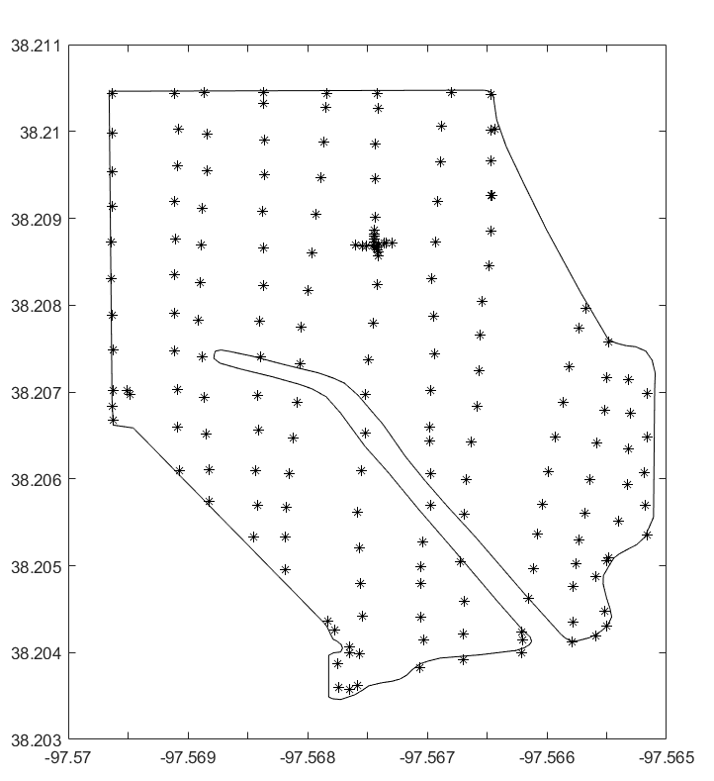
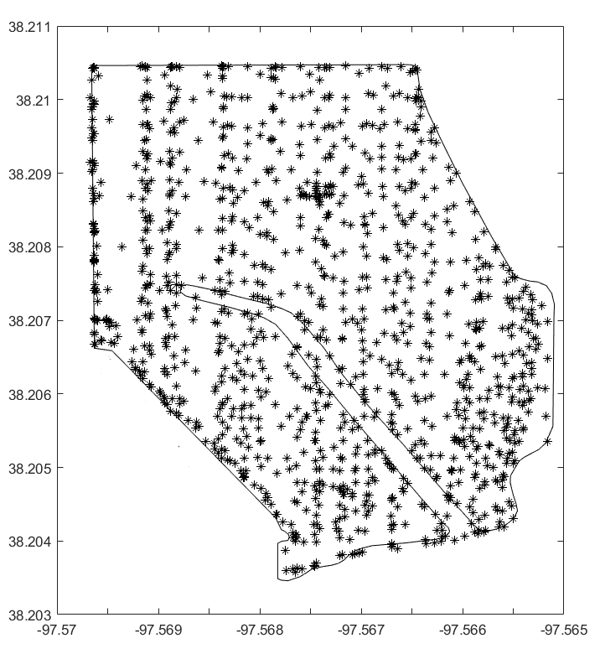
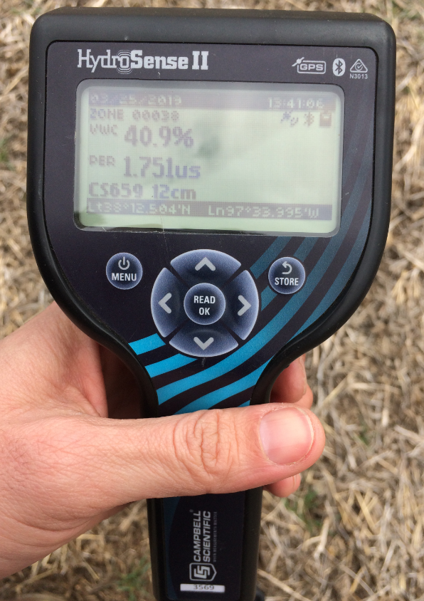
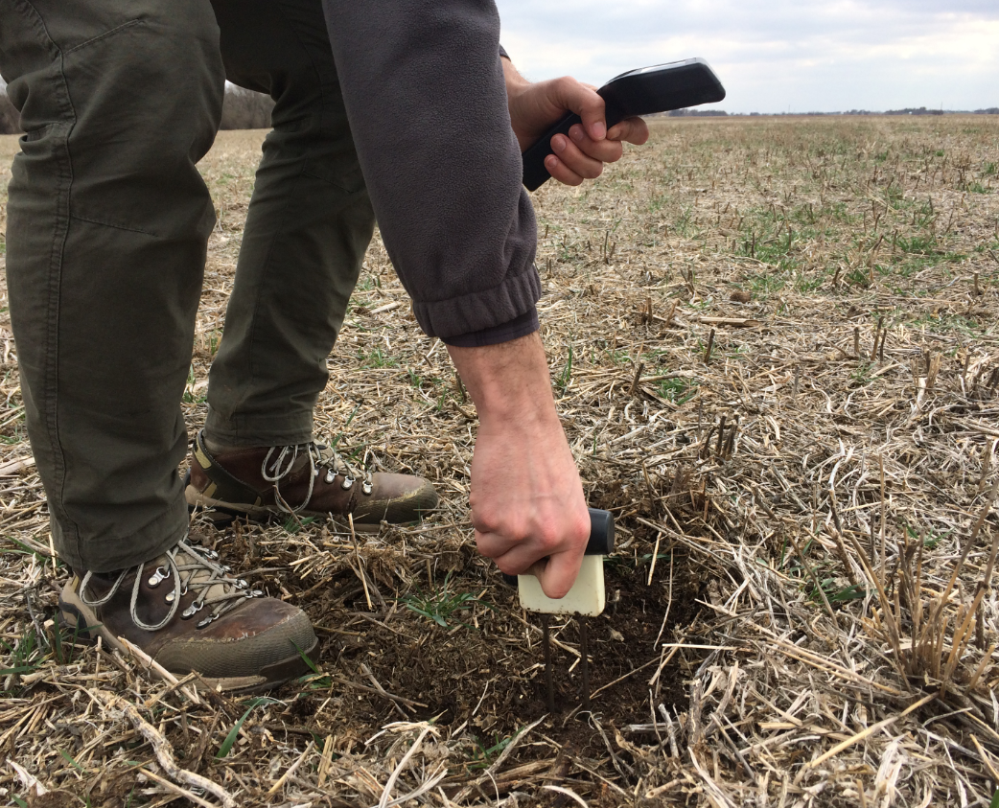
Field Work
Soil moisture samples location
Soil moisture data collection
Total of 6 surveys (times) during the fallow period
HydroSense II with 12-cm rods (Campbell Scientific)
Collection of volumetric water content (%), along with Geographic coordinates
A total of 1200 soil moisture measurements

Slide 8
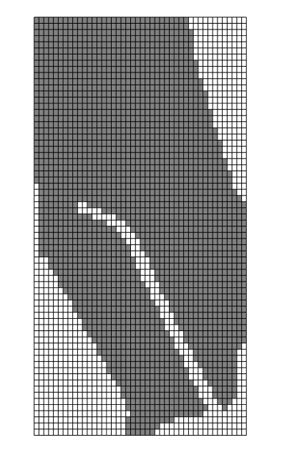
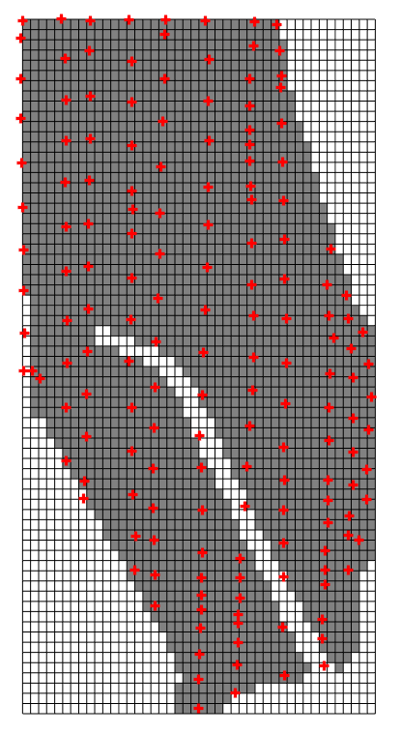
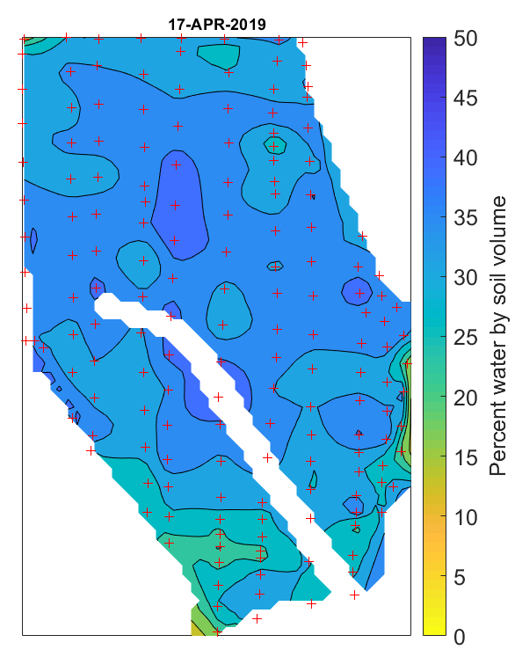
Soil moisture data interpolation
Create a regular grid
Insert the moisture samples
Interpolated soil moisture map
Notes:
3100 cells
80 m2

Slide 9
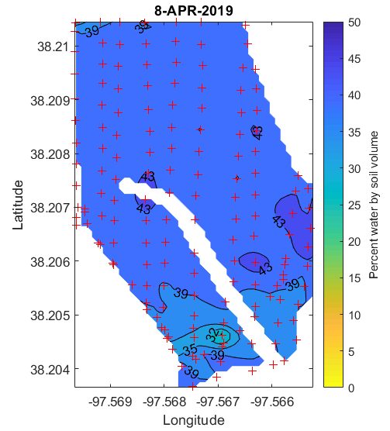
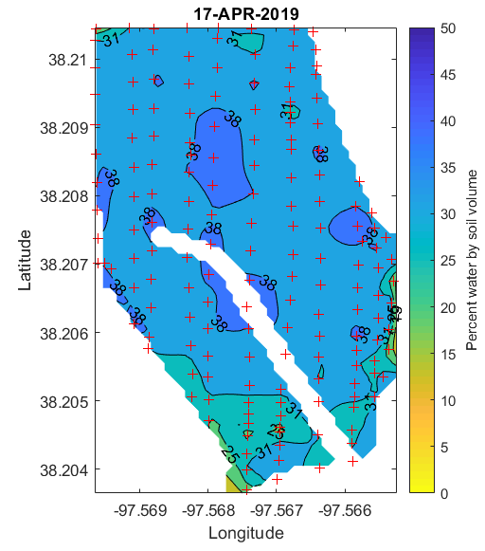
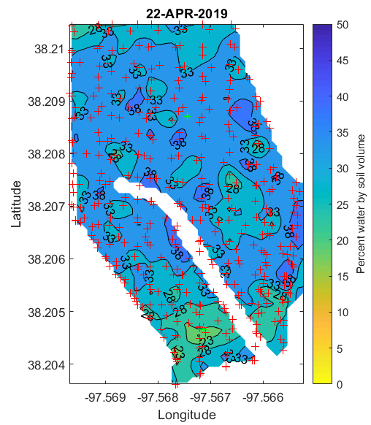
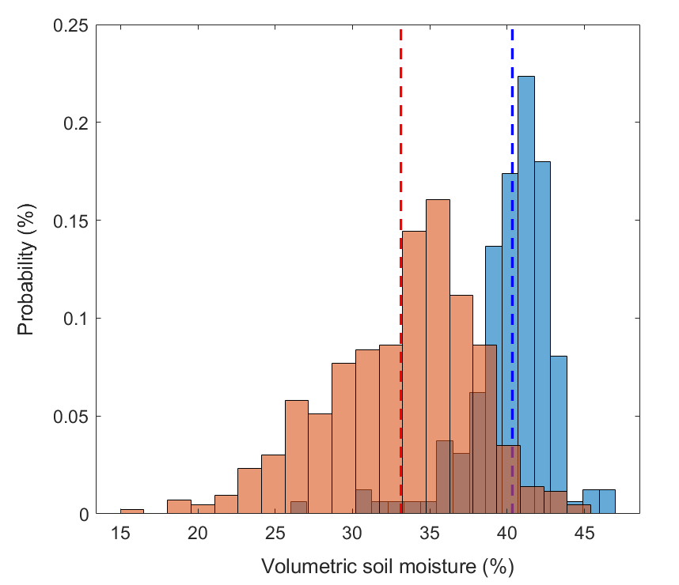
Different field soil moisture conditions
Wet condition
Dry condition
Mean = 40.7%
Std = 1.96
Mean = 33.2%
Std = 3.66
Notes:
Going back to the soil momisture surveys
We went to the field several times to during the Fallow period
Central pivot half (54 acres)
7 soil moisture surveys during the fallow
April to May
Surveys decided in function of soil moisture conditions

Slide 10
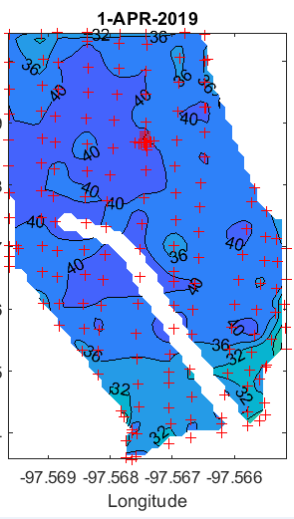
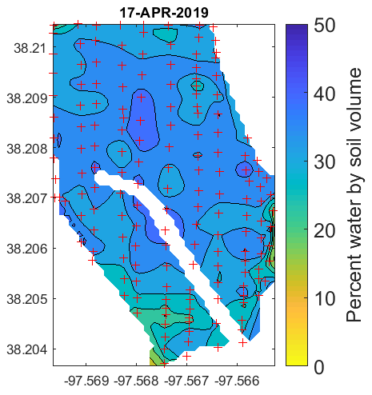
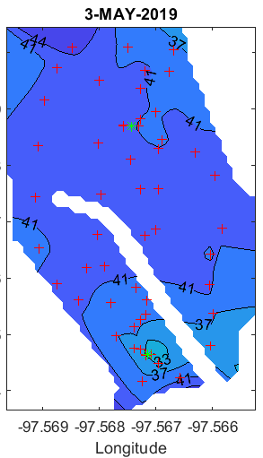
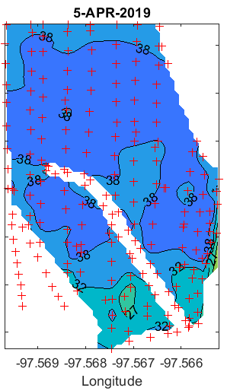
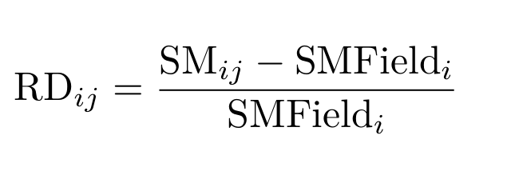
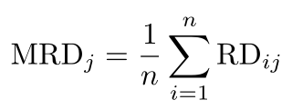
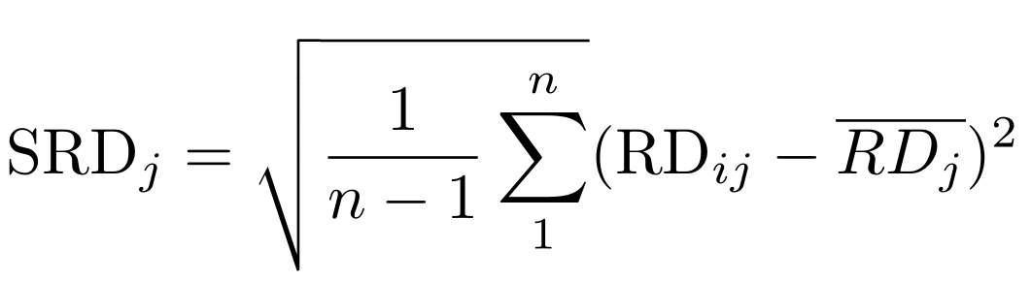
Time stability analysis
Soil moisture interpolated maps
Soil moisture relative difference
Survey 6
Survey 5
Survey 4
Survey 3
Survey 2
Survey 1
Standard deviation Relative Difference
Mean Relative Difference

Slide 11
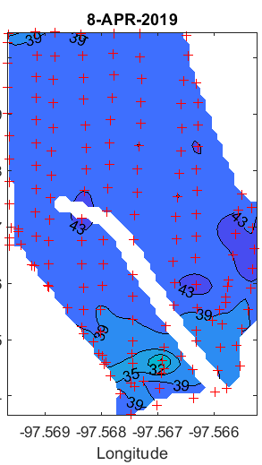
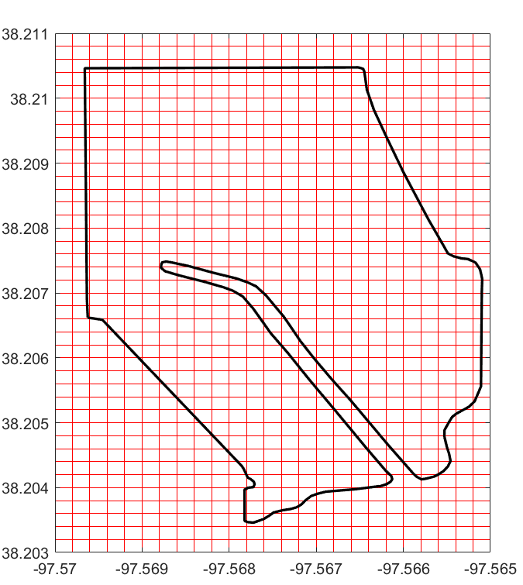
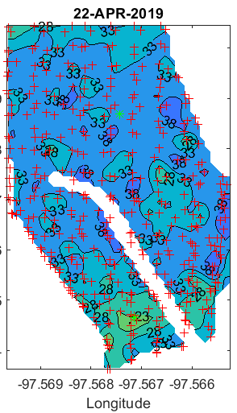
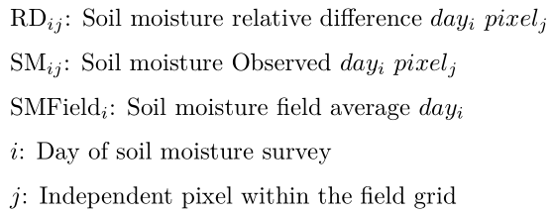
Time stability analysis
Mean Relative Difference
i-6
i-5
Soil moisture Surveys
i-4
i-3
i-2
i-1
j
Standard deviation Relative Difference

Slide 12
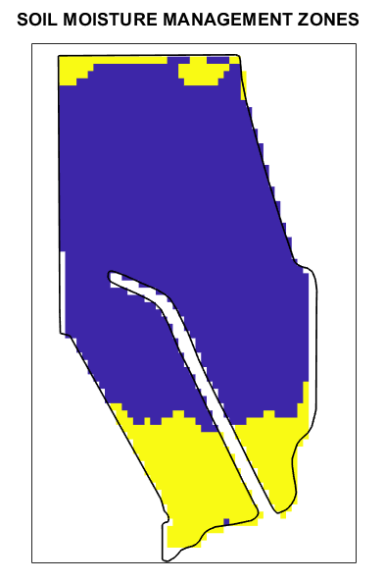
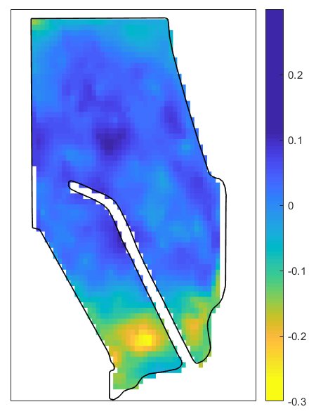


Determine the Soil moisture managements zones
Mean Relative Difference map
Soil Moisture Management Zones
K-means clustering technique
Silhouette evaluation method to find the optimal number of clusters (Rouseeuw, 1987)
2 optimal number of clusters
Wetter than the average
Dryer than the average
Notes:
K means is a partitioning method, most common used
he silhouette plot displays a measure of how close each point in one cluster is to points in the neighboring clusters. This measure ranges from +1, indicating points that are very distant from neighboring clusters, through 0, indicating points that are not distinctly in one cluster or another, to -1, indicating points that are probably assigned to the wrong cluster. silhouette returns these values in its first output.
The silhouette value for each point is a measure of how similar that point is to points in its own cluster, when compared to points in other clusters
The silhouette value ranges from -1 to +1. A high silhouette value indicates that i is well-matched to its own cluster, and poorly-matched to neighboring clusters. If most points have a highsilhouette value, then the clustering solution is appropriate. If many points have a low or negative silhouette value, then the clustering solution may have either too many or too few clusters. The silhouette clustering evaluation criterion can be used with any distance metric.

Slide 13
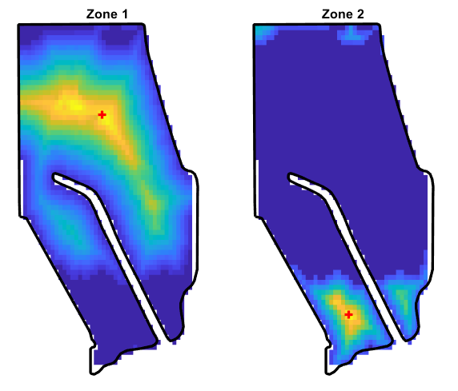
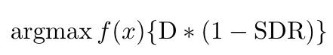
Find the optimal location to sit the moisture sensors
Soil Moisture Management Zones
The most centralized pixel inside each zone
The least variable across time
Bwdist function that computes the Euclidean distance transform for each cell inside the zone (Maurer, 2003)
+ Optimal location of the soil moisture sensors for each zone.
Zone 1: Wetter zone, Zone 2: Dryer zone
Values closer to 1 indicates more centralized pixels
Wetter than the average
Dryer than the average
Notes:
Distance from the edges of the zone
Weighted by the temporal stability using the standard deviation fro each pixel
BWDIST Distance transform of binary image computes the Euclidean distance transform of the binary image BW. For each pixel in BW, the distance transform assigns a number that is the distance between that pixel and the nearest nonzero pixel of BW

Slide 14
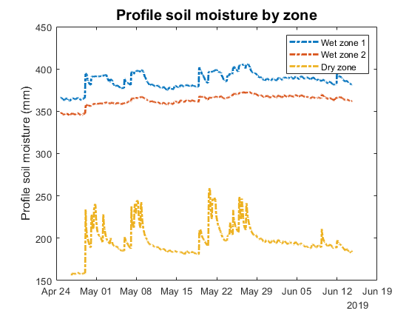
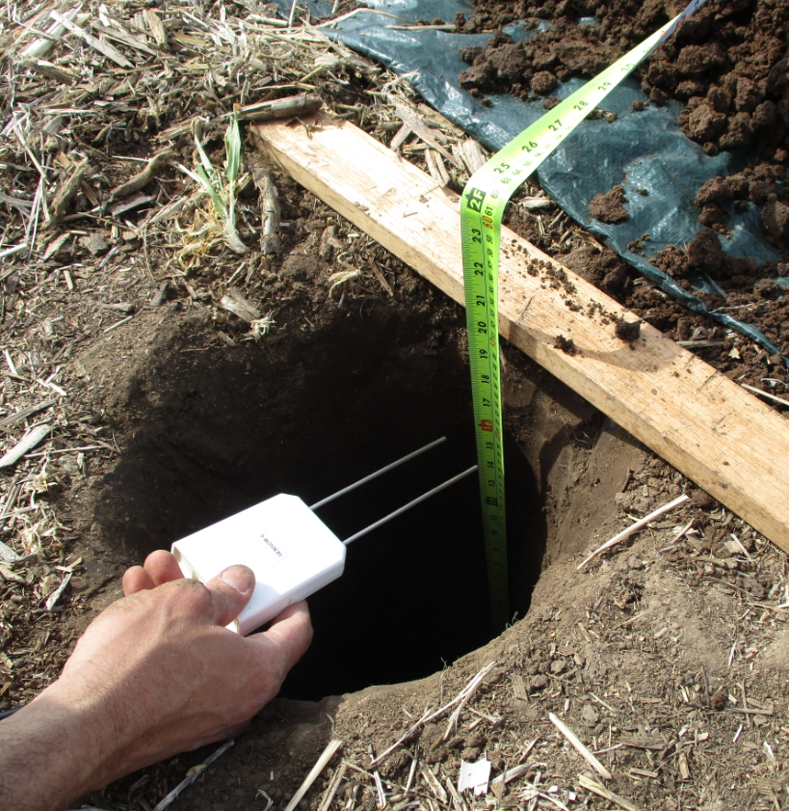
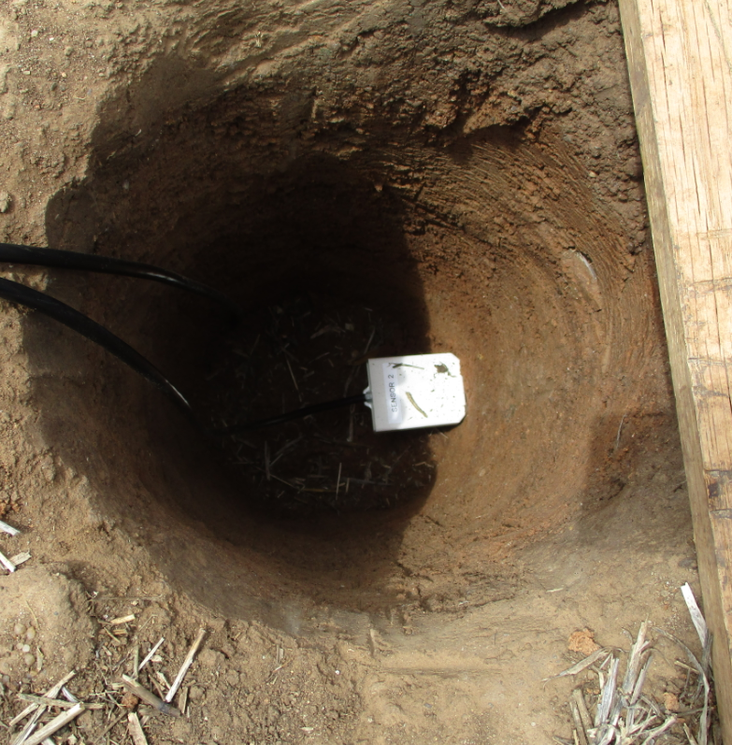
Soil moisture by defined zone
Planting date
Notes:
Make a new plot

Slide 15
Conclusions
We were able to determine soil moisture management zones using a temporally stability analysis
We developed a protocol to determine the optimal siting of soil moisture sensors in an irrigated fields

Slide 16
Future work
Better understanding of soil physical properties that are governing the distinct soil moisture patterns of the fields
Explore alternatives clustering and cluster evaluation approaches
Define a metric to determine the maximum number of clusters and the maximum number of soil moisture sensors

Slide 17
References
Flowers, M., Weisz, R., & White, J. G. (2005). Yield-based management zones and grid sampling strategies. Agronomy Journal, 97(3), 968-982.
Fraisse, C. W., Sudduth, K. A., & Kitchen, N. R. (2001). Delineation of site-specific management zones by unsupervised classification of topographic attributes and soil electrical conductivity. Transactions of the ASAE, 44(1), 155.
Maurer, Calvin, Rensheng Qi, and Vijay Raghavan, "A Linear Time Algorithm for Computing Exact Euclidean Distance Transforms of Binary Images in Arbitrary Dimensions," IEEE Transactions on Pattern Analysis and Machine Intelligence, Vol. 25, No. 2, February 2003, pp. 265-270.
Ortega, R. A., & Santibáñez, O. A. (2007). Determination of management zones in corn (Zea mays L.) based on soil fertility. Computers and Electronics in agriculture, 58(1), 49-59.
Rouseeuw, P. J. “Silhouettes: a graphical aid to the interpretation and validation of cluster analysis.” Journal of Computational and Applied Mathematics. Vol. 20, No. 1, 1987, pp. 53–65

Slide 18


Acknowledge
Dr. Andres Patrignani
Dr. Ignacio Ciampitti
Dr. Trevor Hefley
Patrignani’s Lab
Ray and Ryan Flickner
https://github.com/prossini1/Optimal-siting-of-soil-moisture-sensors-in-irrigated-fields
Thanks
Funding agency
Questions
Suggestions

Slide 19
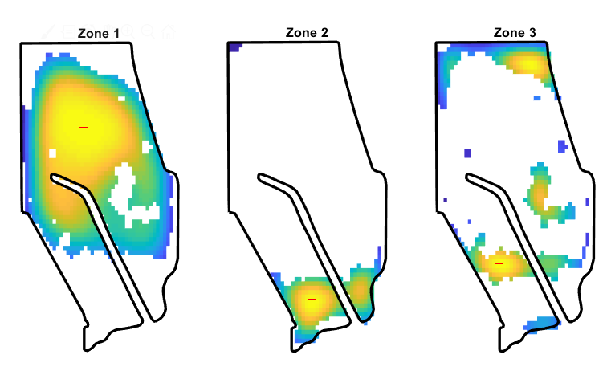
How to find the optimal locations to sit the SMS

